Slide 1
Chapter Four
Advanced Sorting Algorithm
ITec2052:
Data Structure and Algorithme
by Serkalem.M
ArbaMinch university

Slide 2
Efficient Sorting Algorithms
Shell Sort
Heap Sort
Quick sort
Merge-sort

Slide 3
Shell Sort
It is a highly efficient sorting algorithm and is based on insertion sort algorithm.
This algorithm avoids large shifts as in case of insertion sort, if the smaller value is to the far right and has to be moved to the far left.
As this algorithm is an extension of insertion sort, it uses insertion sorting as well.
The original array is first divided into a number of smaller subarrays based on the number of gap.
Here we compare the left values with the right values based on gaps or intervals.

Slide 4
Cont..
When we use the gap to compare the far elements, with each set of comparisons, we decrease the value of the gap.
Once the algorithm reaches the point where the gap value is 1, it uses insertion sort.
These subarrays are sorted, and then they are combined into the overall array and this is sorted.

Slide 5
N=11
Gap1=N/2=5
Gap2=Gap1/2=N/4=2
Gap3=Gap2/2=N/8=1
Example:
0
1
2
3
4
5
6
7
8
9
10
A
10 | 8 | 6 | 20 | 4 | 3 | 22 | 1 | 0 | 15 | 16
10 |  |  |  |  | 3 |  |  |  |  | 16
 | 8 |  |  |  |  | 22
 |  | 6 |  |  |  |  | 1
 |  |  | 20 |  |  |  |  | 0
 |  |  |  | 4 |  |  |  |  | 15
Before sorting with gap= 5
3 |  |  |  |  | 10 |  |  |  |  | 16
 | 8 |  |  |  |  | 22
 |  | 1 |  |  |  |  | 6
 |  |  | 0 |  |  |  |  | 20
 |  |  |  | 4 |  |  |  |  | 15
Swap 10 & 3
No swap or correct order
Array after gap 5
3 | 8 | 1 | 0 | 4 | 10 | 22 | 6 | 20 | 15 | 16

Slide 6
Example:
0
1
2
3
4
5
6
7
8
9
10
A
Array after gap= 5
For Gap2=Gap1/2=N/4=2
3 | 8 | 1 | 0 | 4 | 10 | 22 | 6 | 20 | 15 | 16
3 |  | 1 |  | 4 |  | 22 |  | 20 |  | 16
 | 8 |  | 0 |  | 10 |  | 6 |  | 15
Before sorting with gap 2
Swap with correct order
1 |  | 3 |  | 4 |  | 16 |  | 20 |  | 22
 | 0 |  | 6 |  | 8 |  | 10 |  | 15
1 | 0 | 3 | 6 | 4 | 8 | 16 | 10 | 20 | 15 | 22
Array after gap=2
For gap=1 Use insertion sort
1 | 0 | 3 | 6 | 4 | 8 | 16 | 10 | 20 | 15 | 22
0 | 1 | 3 | 4 | 6 | 8 | 10 | 15 | 16 | 20 | 22
Sorted array
after gap=1

Slide 7
Time Complexity of Shell Sort
Worst Time Complexity | O(n²)
Average Time Complexity | O(n^{5/4})
Best Time Complexity | O(n^{3/2})

Slide 8
Heap Sort
Heap sort is one of the sorting algorithms used to arrange a list of elements in order and it use tree concepts.
It is a comparison-based sorting technique based on Binary Heap data structure.
It is similar to selection sort.
First find the maximum element and place the maximum element at the last part of array.
We repeat the same process for the remaining elements.

Slide 9
Cont..
A heap is a binary tree that has two properties:
The value of each node is greater than or equal to the values stored in each of its children.
The tree is perfectly balanced, and the leaves in the last level are all in the leftmost positions.
A property of the heap data structure is that the largest element is always at the root of the tree.
Time complexity for heap sort
    Best case =O(n)
    Worst case=O(n log n)
    Average case=O(n log n)

Slide 10
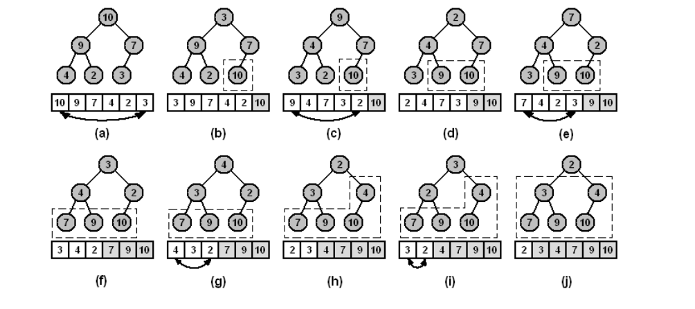
Example:
10 | 9 | 7 | 4 | 2 | 3

Slide 11
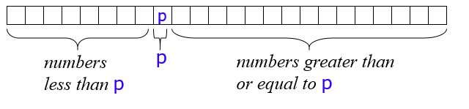
Quicksort
A key step in the Quicksort algorithm is partitioning the array
  We choose some (any) number p in the array to use as a pivot
  We partition the array into three parts:

Slide 12
Quicksort..
Choose an array value (say, the first) to use as the pivot
Starting from the left end, find the first element that is greater than or equal to the pivot
Searching backward from the right end, find the first element that is less than the pivot
Interchange (swap) these two elements
Repeat, searching from where we left off, until done

Slide 13
Quicksort…
To partition a[left...right]:
1. Set pivot = a[left], l = left + 1, r = right;
2. while l < r, do
  2.1. while l < right & a[l] < pivot , set l = l + 1
  2.2. while r > left & a[r] >= pivot , set r = r - 1
  2.3. if l < r, swap a[l] and a[r]
3. Set a[left] = a[r], a[r] = pivot
4. Terminate

Slide 14
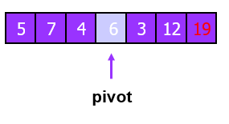

example
.
.
.
5 | 7 | 4 | 3 | 6 | 12 | 19
3 | 4 | 5 | 6 | 7 | 12 | 19

Slide 15
  Merge-sort
Merge sort is one of the most efficient sorting algorithms.
It works on the principle of Divide and Conquer.
Merge sort repeatedly breaks down a list into several sub lists until each sub list consists of a single element.
And merging those sub lists in a manner that results into a sorted list.
Three steps to complete merge sorting
  Divide: the array/list divides itself recursively into sub-arrays until the base case is reached.
  Recursively solve: the sub-arrays are sorted using recursion.
  Combine: This step makes use of the merge( ) function to combine the sub-arrays into the final sorted array.

Slide 16
Time complexity
For merge sort, the best, average and worst case complexities are all the same.
Best case=O(n log n)
Worst case=O(n log n)
Average case= O(n log n)

Slide 17
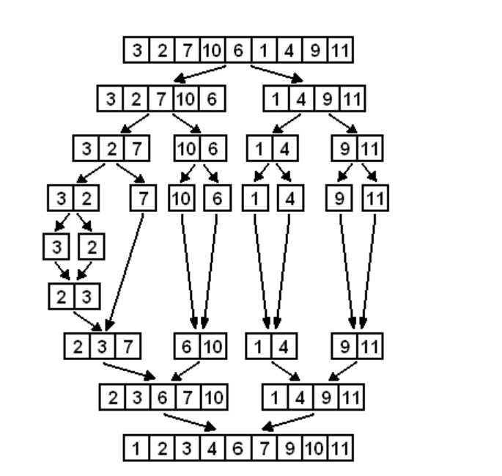
3 | 2 | 7 | 10 | 6 | 1 | 4 | 9 | 11
Example: A

Slide 18
END

